Slide 1

Uber Data Analysis

Slide 2

Business Problem
Uber wants to optimize its ride-booking operations by analyzing patterns in ride volume, booking outcomes, vehicle usage, and customer satisfaction. The goal is to reduce ride failures, improve rider-driver experience, and boost platform efficiency through data-driven insights

Slide 3





Project Objective
Identify peak ride timings and patterns across the month
Understand reasons behind ride cancellations and failures
Evaluate customer and driver satisfaction through ratings
Analyze payment method performance and revenue generation
Recommend data-driven actions to improve operational efficiency
To analyze Uber ride data from July 2024 to uncover trends and issues across ride volume, booking status, customer behavior, and revenue channels.

Slide 4
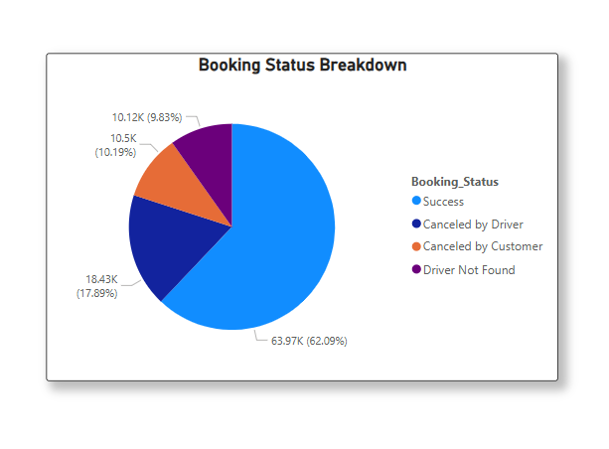
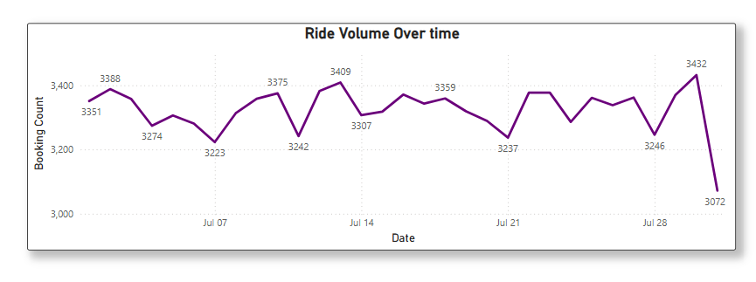
Ride Volume & Booking Status
Ride Volume Over July
Booking Status Breakdown
July 27 saw peak demand (~3442 rides). Clear weekday-weekend fluctuations.
63.87% successful rides; driver cancellations (17.69%) > customer cancellations (9.99%)

Slide 5
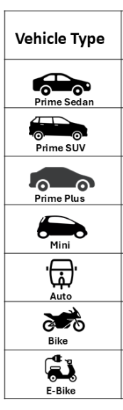
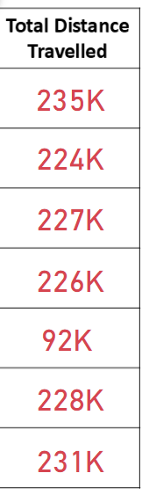
Vehicle Type & Ride Distance
Key Insight
Prime Sedan has highest ride distance, followed by E-Bike and Sedan.
Strategic Implication
Focus on optimizing Prime Sedan fleet based on high utilization.

Slide 6
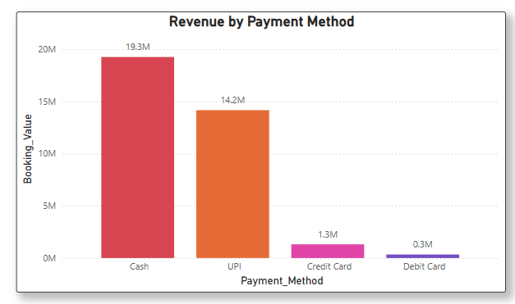
Revenue Contribution by Payment Method
Key Insights:
Cash is the most preferred payment method, contributing ₹19.3M in revenue.
UPI follows closely with ₹14.2M, showing a strong digital adoption.
Credit Card usage is limited, contributing only ₹1.3M.
Debit Card revenue is the lowest at ₹0.3M, indicating it's the least preferred method.

Slide 7
Ratings Analysis
4.8
4.3
4.2
Prime Sedan Rating
E-Bike Rating
Sedan Rating
Highest customer satisfaction
Moderate satisfaction level
Opportunity for improvement
Insight:
Premium vehicle types like Prime Sedan consistently receive higher customer ratings.
E-Bikes and Sedans show moderate satisfaction levels, signaling service improvement opportunities.
Customers generally rate drivers higher than drivers rate customers.
This pattern highlights potential mismatches in service expectations and feedback.

Slide 8
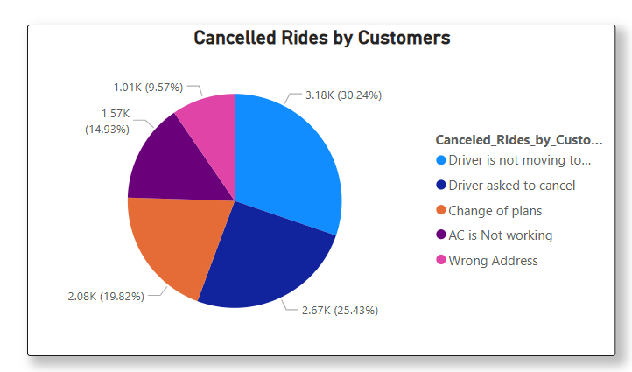
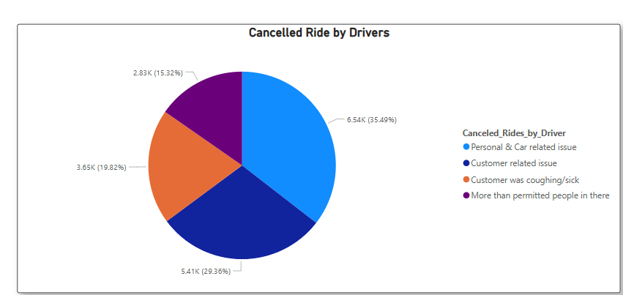
Cancelled Ride Analysis – Customers vs. Drivers
Cancelled Rides by Customers
Driver Cancellations
30.2% due to driver not moving
35.5% personal or car issues
25.4% drivers ask customers to cancel
29.4% customer-related problems
Plan changes and AC issues common
19.8% health concerns (sick, coughing)
Wrong address is least common
15.3% over-capacity passengers

Slide 9





Recommendations & Conclusion
Improve driver availability
Lower cancellations and "driver not found" issues
Incentivize driver performance
Focus on peak hours to meet demand
Promote UPI & Digital Payments
Reduce transaction drop-offs
Improve drive compliance
Monitor and act on drivers who remain idle at pickup points , leading to customer cancellations.
Prioritize customer support
Reward high-value customers with discounts
Conclusion: This Uber data analysis for July 2024 revealed valuable insights into user demand, operational inefficiencies, and revenue drivers. Addressing these areas can help Uber enhance its platform experience, reduce cancellations, and grow rider retention and revenue.

